Slide 1
Artificial Intelligence (CSE5005) Mini Project Presentation (13th March 2025) Creating a Customer Recommendation System based on an Ecommerce platform
By
Under the supervision of
Dr. Raja Jitendra Nayaka Assisstant Professor Department of Computer Science & Engineering ,
Name | Roll Number
Vishnu Priya | 20242AIE0007
Yerrabathina Muni Sekhar | 20242AIE0008
Yenimireddy Venkata Ramireddy | 20242AIE0009
Anas Muhammed Sahil | 20242AIE0010
Rojin K Varughese | 20242AIE0011

Slide 2
Problem Statement
Online shoppers often struggle to find relevant products.
Traditional recommendation systems rely on explicit user data, which may be unavailable.
Need a lightweight, client-side recommendation system that runs in the browser.
Goal: Use image-based similarity to recommend visually similar products.

Slide 3
Gameplan to address the Problem
Approach:
Use FakeStoreAPI as a mock e-commerce database.
MobileNet (pre-trained CNN model) to extract product image features.
TensorFlow.js to compute similarity between product images in the browser.
Deploy as a lightweight web application with real-time recommendations.

Slide 4
Project Timeline
System Design & Setup
Model Integration & Similarity Computation
Building the UI
& Deployment

Slide 5
Phase 1 - System Design & Setup
Define requirements & architecture.
Set up TensorFlow.js
Set up FakeStoreAPI.
Load & preprocess product images.

Slide 6
Phase 2 - Model Integration and similarity computation
Use MobileNet to extract image embeddings.
Compute cosine similarity between products.
Generate list of similar products

Slide 7
Phase 3 - Building the UI & Deployment
Create a simple UI with HTML, BulmaCSS
Deploy as a browser based app.

Slide 8
Implementation
The project is implemented in JavaScript with an online API to generate products and a “MobileNET” is used to create a list of similar products.

Slide 9
Implementation - Tensorflow.js
A JavaScript library for machine learning, enabling AI models to run directly in the browser.
Supports pre-trained models like MobileNet and allows on-the-fly model training.
Uses WebGL acceleration for efficient performance without requiring a backend server.

Slide 10
Implementation - MobileNET
A lightweight, pre-trained CNN model optimized for mobile and web applications.
Uses depthwise separable convolutions to reduce computational cost while maintaining accuracy.
Ideal for feature extraction in image-based machine learning tasks like similarity detection

Slide 11
Implementation - FakestoreAPI
A free, fake e-commerce REST API providing product data like images, titles, prices, and categories.
Useful for prototyping and testing recommendation systems without needing real product databases.
Supports simple API calls (in JSON), which makes it easy to integrate into JavaScript-based applications.

Slide 12
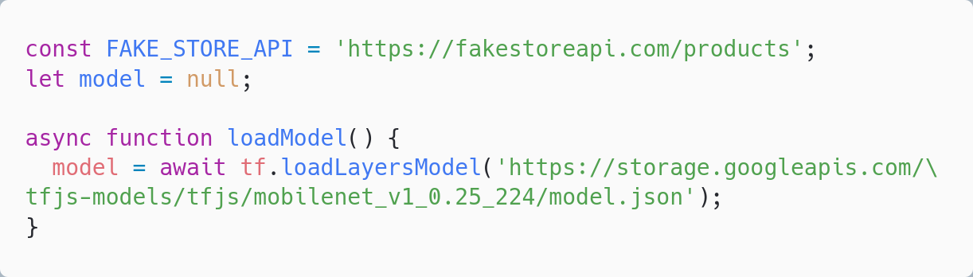
Implementation - Initial setup

Slide 13
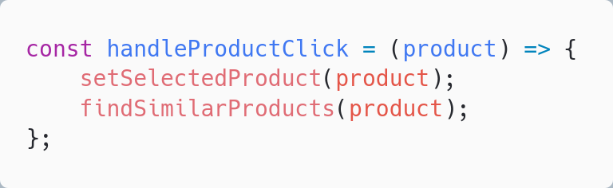
Implementation - Finding similar products

Slide 14
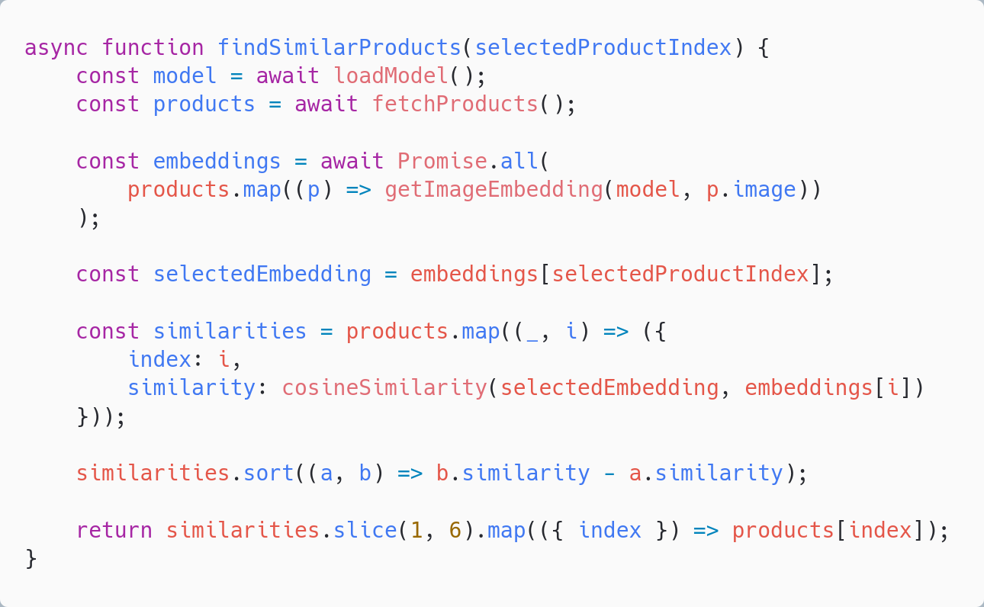
Implementation - Finding similar products

Slide 15
Expected Challenges & Mitigation
Problem | Solution
Performance issues in browser | Optimize with WebGL-backed TF.js execution
Low-quality product images | Preprocess images before extracting features
Scalability concerns | Use approximate nearest neighbors for large datasets

Slide 16
Conclusion & Next Steps
Built a lightweight, AI-powered recommendation system using Tensorflow.js and MobileNet.
Next Steps:
Implement in a demo e-commerce store.
Gather feedback and optimize performance.
Extend with additional ML models.

Slide 17
Q&A

Slide 18
Thank you !!

